Slide 1
PROMOTING EQUITY IN EDUCATION
UNIT 1: CONCEPTS AND FRAMEWORKS
MEL AINSCOW

Slide 2
Education for All

Slide 4
The Framework for Action
‘Inclusion and equity in and through education is the cornerstone of a transformative education agenda…..’

Slide 5
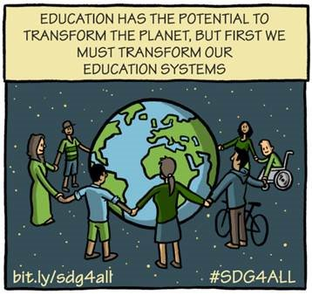

Slide 6
What do we mean by equity?

Slide 7
An ecology of equity
Within schools - issues that arise as a result of school and teacher practices
Between schools - issues that arise from the characteristics of the local school system.
Beyond schools - issues related to the wider context within which schools operate

Slide 8
‘Coopetition’: collaboration between competitors, in the hope of mutually beneficial results
Partners who see clear and tangible benefits from collaboration
Trust between partners, established through the careful development of relationships between key actors
Clear goals and agreements between partners
Forms of leadership that are skilful in managing tensions

Slide 9
Review questions:
How far do you think the education system is equitable?
What do you see as the greatest challenges as far as inclusion and fairness are concerned?

Slide 10
PROMOTING EQUITY IN EDUCATION
UNIT 1: CONCEPTS AND FRAMEWORKS
MEL AINSCOW

